Slide 13
GUIDANCE FOR SLIDE DEVELOPMENT
Text default is Arial; default sizing for header text should be all capitalized/size 50, body text should be sentence case/size 32, and sub-bullet text should be sentence case/size 28
When choosing slide colors please alternate between the various Civitas colors [OR] use all one color

Slide 14
GUIDANCE CONTINUED
Please only use the brand colors reflected in the color palette of this template deck
When creating slides with bullets, please be conscious of how much text you’re putting on the slide. Ask yourself “is this legible?” and/or “would I be overwhelmed by looking at this slide in someone else’s presentation?”
It is best practice to use more imagery and less words where possible. Use the notes section if you need reference language for your presentation

Slide 15
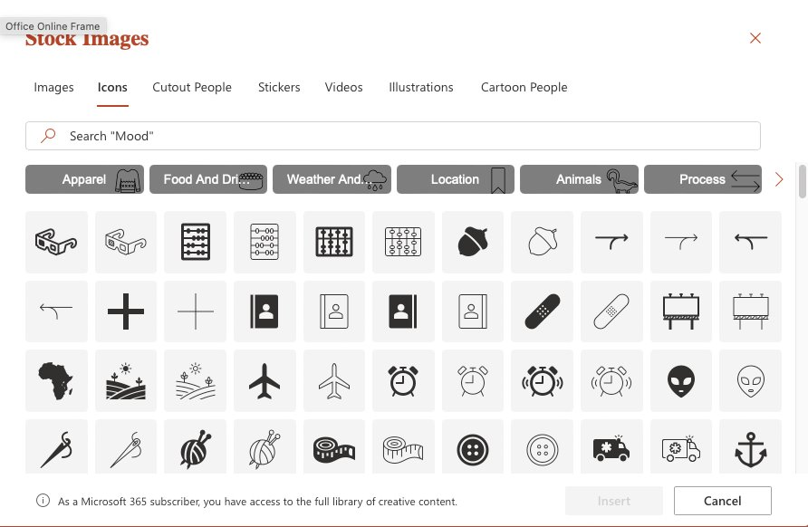
ICONOGRAPHY GUIDANCE
To add imagery, please utilize the iconography library on PowerPoint. You can access this here:
Click Insert in the header navigation
Click Icons
Browse the stock icons for relevant visuals.

